Slide 1
A Novel Embedding Architecture and Score Level Fusion Scheme for Occluded Image Acquisition in Ear Biometrics System
National Conference on Communications 2023, IIT Guwahati
Feb 25, 2023
Presented by:
Archishman Biswas
Authors:
Archishman Biswas, Goutham A P, Saket Pateriya, Divyang S. Jadav, Satish Mulleti and Vikram M. Gadre
Department of Electrical Engineering, Indian Institute of Technology Bombay, India 400076

Slide 2
Introduction to Ear Biometrics
1

Slide 3
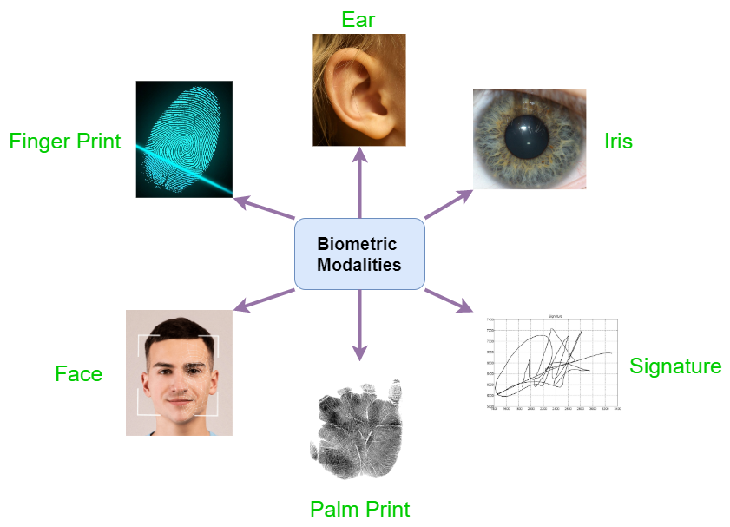
Biometrics
(Bio=life; Metrics=measurement)
Biometric is the science of determining an individual’s unique identity based on one or more distinguishing physical or behavioural characteristics.

Slide 4
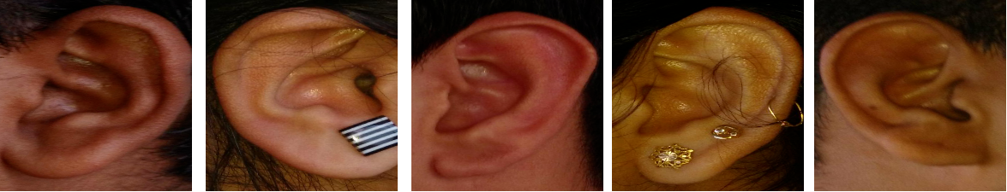
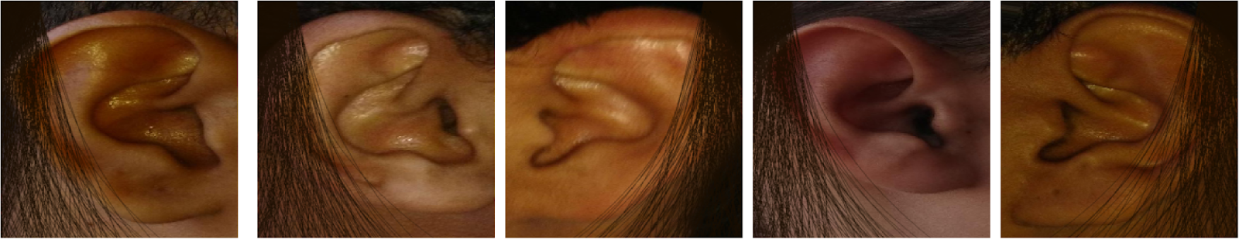
Ear Biometrics
Past studies have shown that ears are unique for each individual.
Ear image acquisition process is contactless and non-intrusive.
Ear is consistent and doesn’t change with expressions.
We use our own IITB-dataset for studying ear based biometrics
1000 ear images of 100 subjects, 5 images of each side ear, all of size (224,224,3)
We have also studied the effect of occlusions due to hair, for this, we have added artificial random occlusions (covering 35% of the image on average)

Slide 5
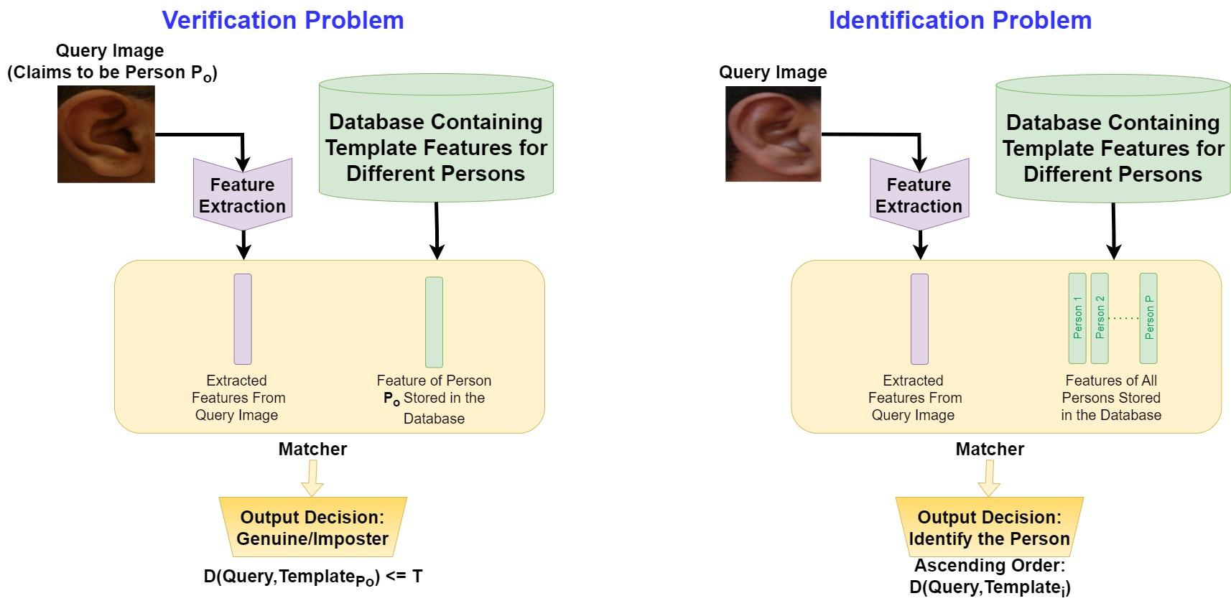
Verification and Identification Problems in Biometrics

Slide 6
Embedding Network and Siamese Training
2

Slide 7
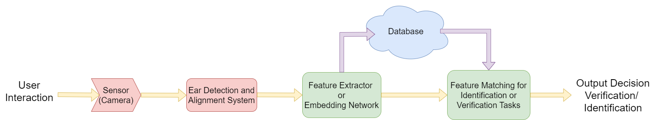
Pipeline of Ear Biometrics System
The initial detection and alignment system is an important preprocessing step that gets rid of many of the irrelevant background information
Our proposed innovations are only in the Embedding Network and Feature Matching systems/blocks

Slide 8
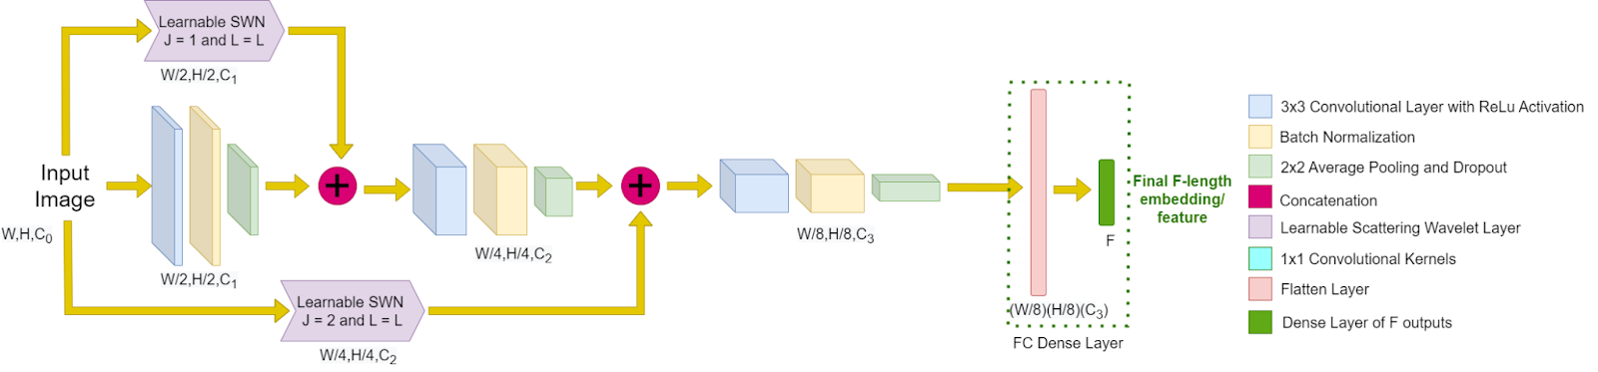
Embedding Network Used
The architecture of the embedding network consists of conventional CNNs in the central path and learnable Scattering Wavelet Network (SWN) in the parallel paths
The parallel learnable SWN paths pickup information directly from the input image and inserts them into further downstream parts of the embedding network

Slide 9
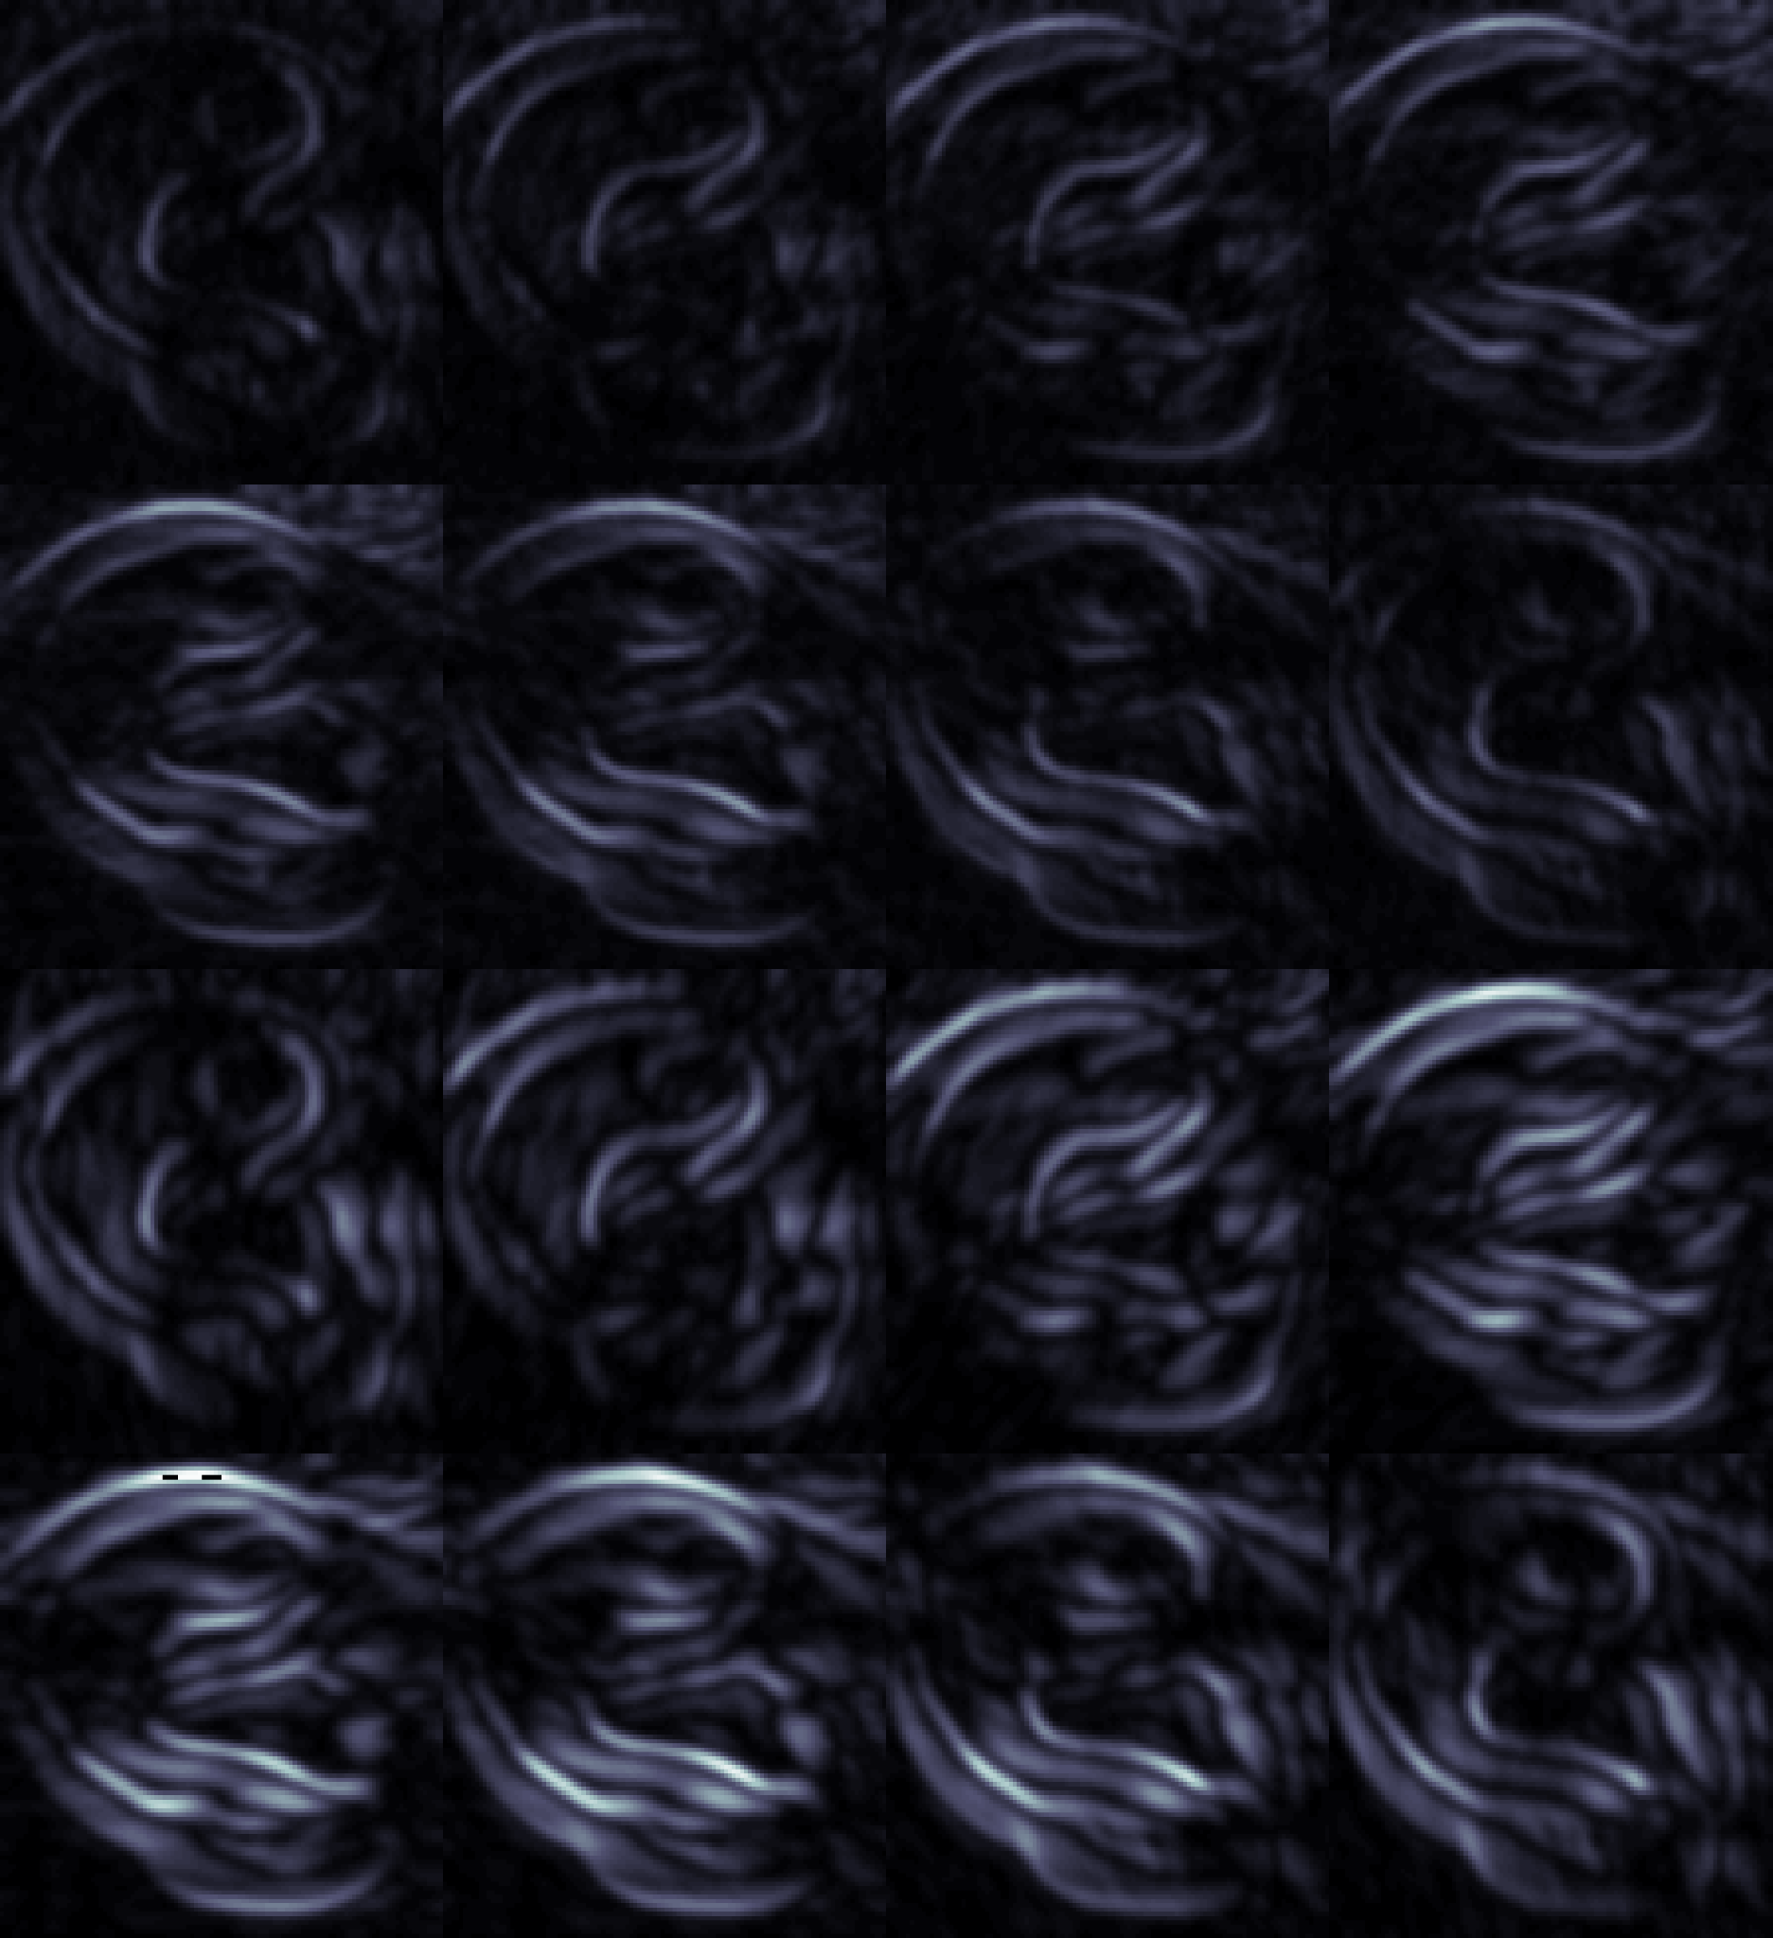
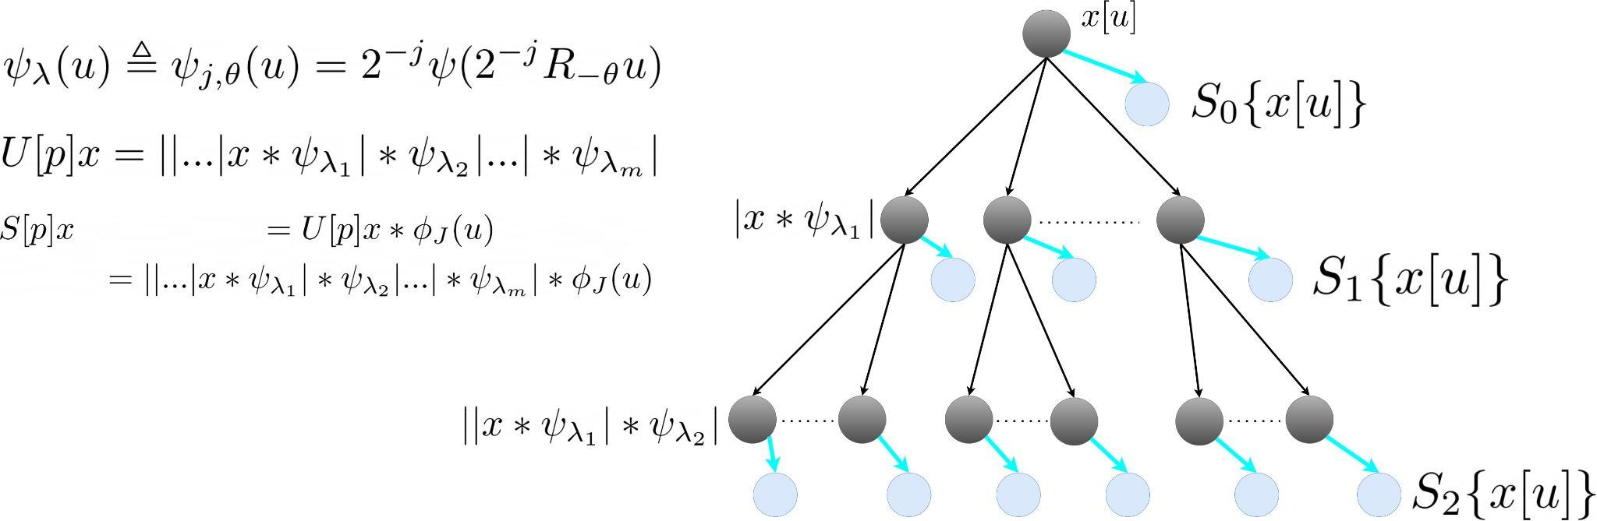
Scattering Wavelet Network

Slide 10
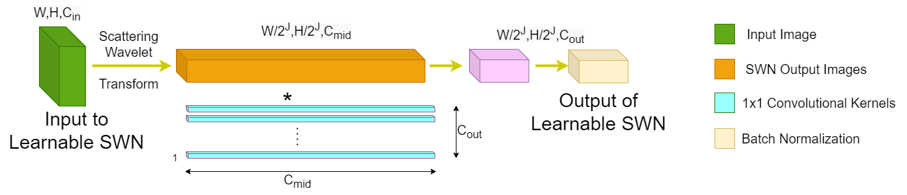
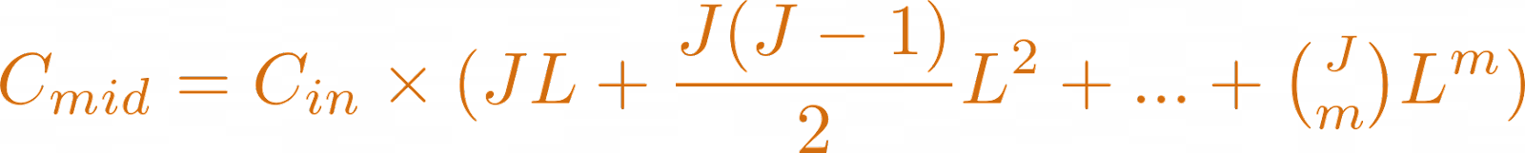
Learnable Scattering Wavelet Network
Number of output channels (denoted by C_{mid}) of SWN is given by:
{0th layer (low-pass) is omitted}
Then, convolution with 1x1 kernel is carried out to learn the linear combination across the C_{mid} channels and finally get C_{out} channels.

Slide 11
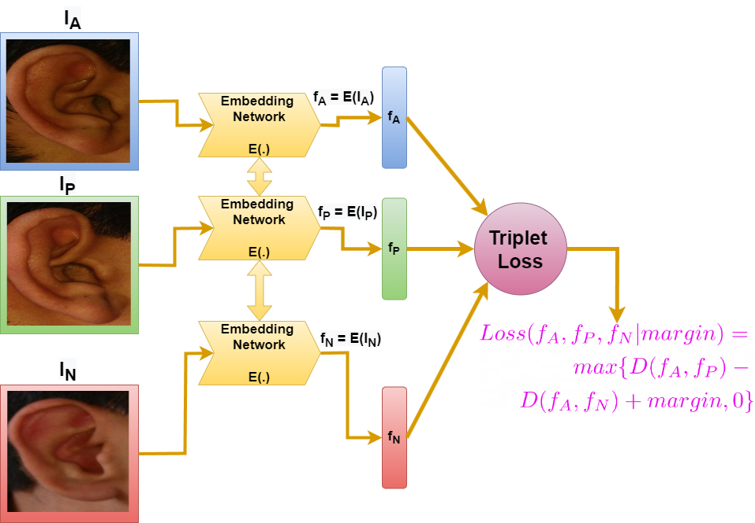
Siamese Training Framework
The siamese training of the network is carried out by providing three images: Anchor(A), Positive(P), and Negative(N) together
The distance D(,) here is taken as the Euclidean distance

Slide 12
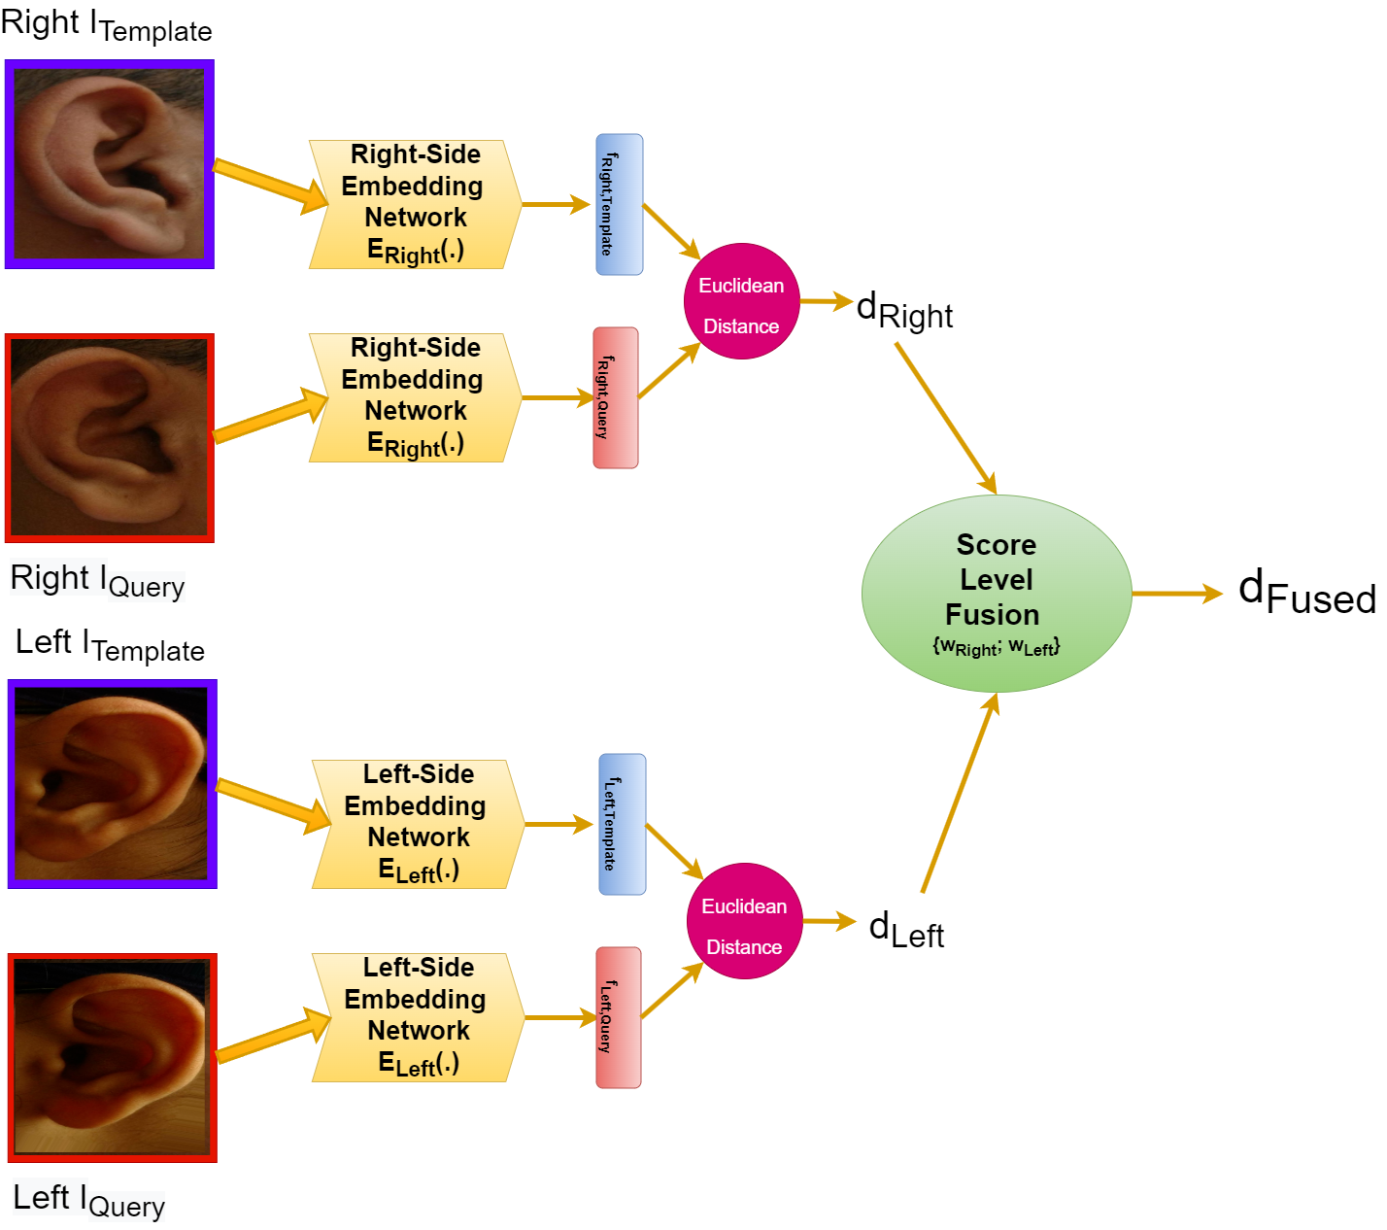
Score Level Fusion: E_{Right} and E_{Left}
For fusing information from both the right side and left side of the image, we use a score level fusion scheme
Hence, we only need a trained left embedding network and a trained right embedding network, no separate training for the fused decision is required

Slide 13
Evaluation Metrics for Biometrics System
3

Slide 14
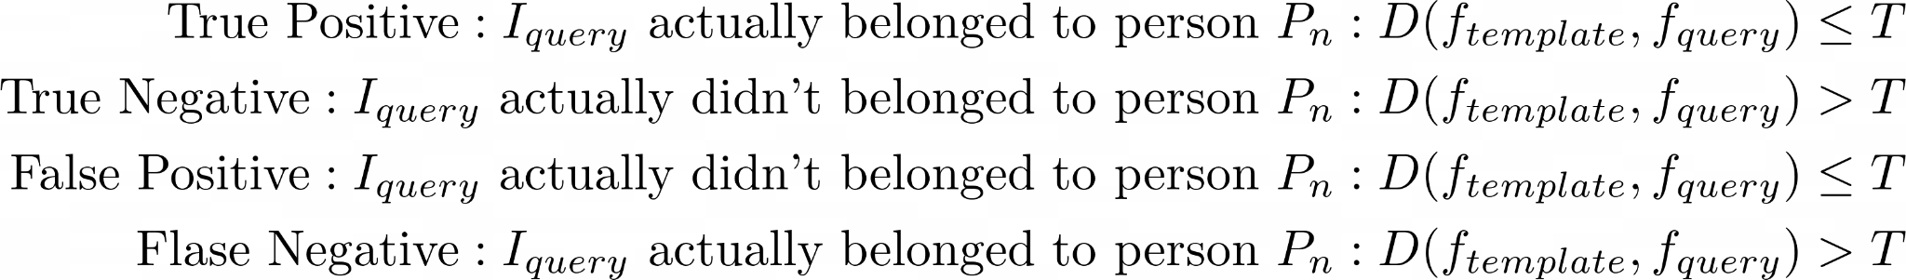
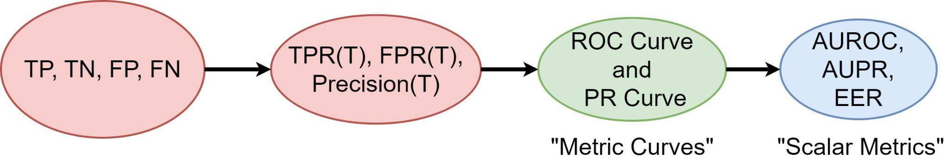
For Verification Problem

Slide 15
For Identification Problem
In identification mode the system returns ranking for the query image, I_{Query} of a person P_{i}. The system is working correctly in Rank-R sense if:
r_{i} ≤ R, for query image of i^{th} person.
Using above results the plot of Rank-R Accuracy versus Rank-R called Cumulative Match Curve (CMC).

Slide 16
Experimental Results
4

Slide 17
Set Hyperparameters and Type of Experimental Settings
Train the embedding network with margin = 1 using Adam optimizer in Keras library with learning rate of 1e-4 and β parameters set to default.
Run the training for 20 epochs with a batch size of 100. Embedding network for each of the ear side is trained for 5 independent trials.
The AUPR, EER and Rank-1 metrics are reported with mean and SD across the 5 trials in the paper for different experimental settings
Experimental settings: “Closed” and “Open” sets; “Clean” and “Occluded” image acquisition; “Clean” and “Augmented” training of model; 3 different embedding network: no parallel paths, L = 4, L = 8

Slide 18
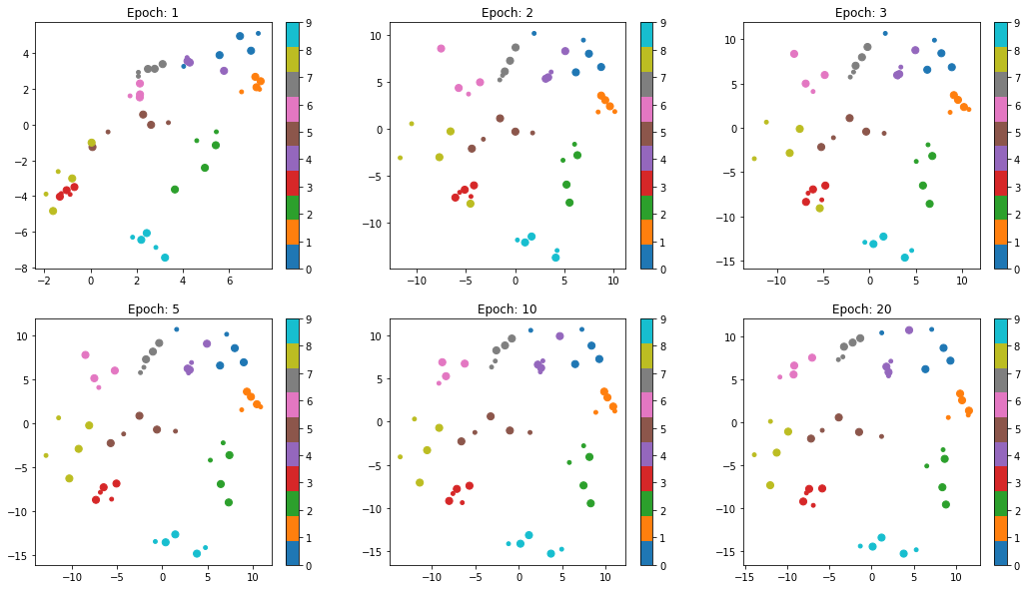
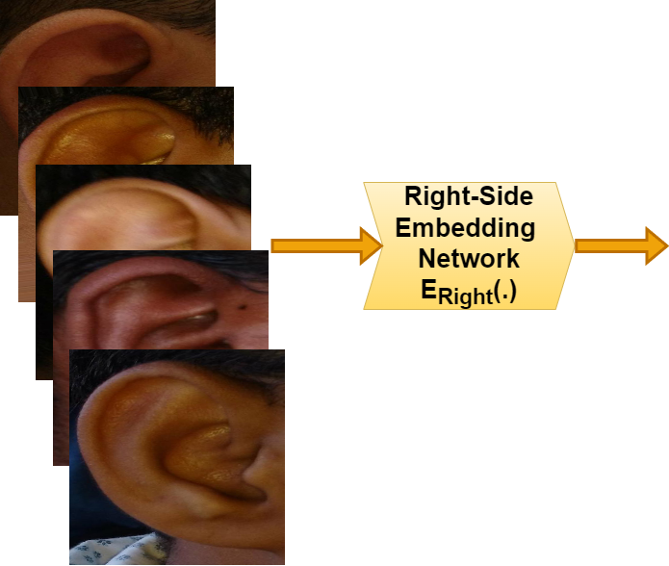
Visualizing the Extracted Features (Right Embeddings)
The figure shows the extracted features (2D projection of 128D vector) from 10 person’s right ear images. Train: Larger dots, Test: Smaller dots.

Slide 19
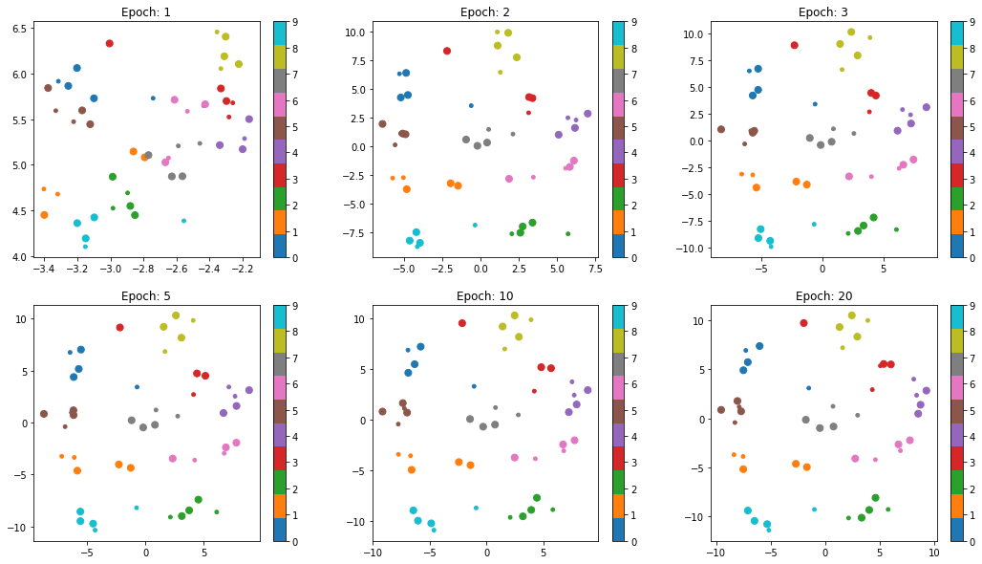
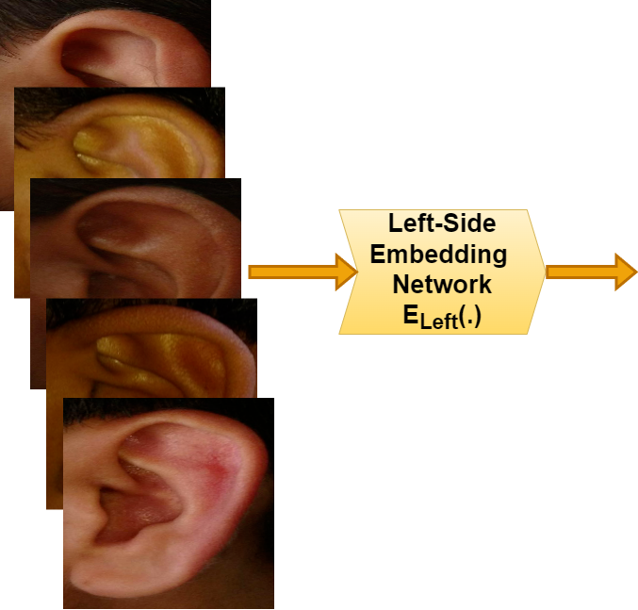
Visualizing the Extracted Features (Left Embeddings)
The figure shows the extracted features (2D projection of 128D vector) from 10 person’s left ear images. Train: Larger dots, Test: Smaller dots.

Slide 20
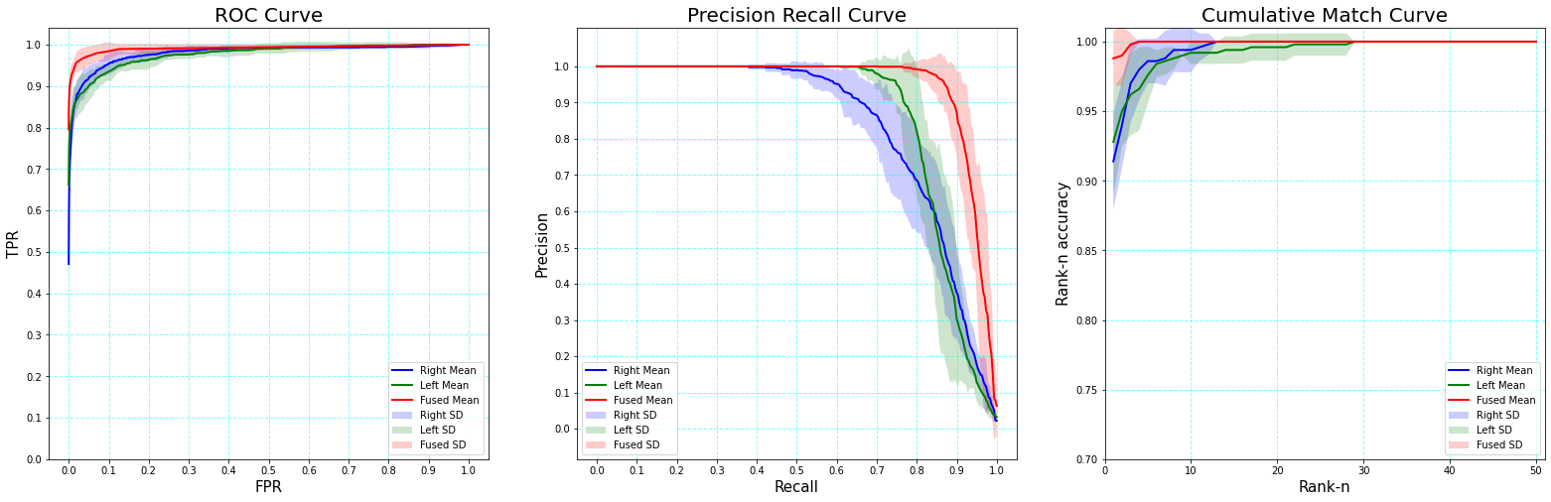
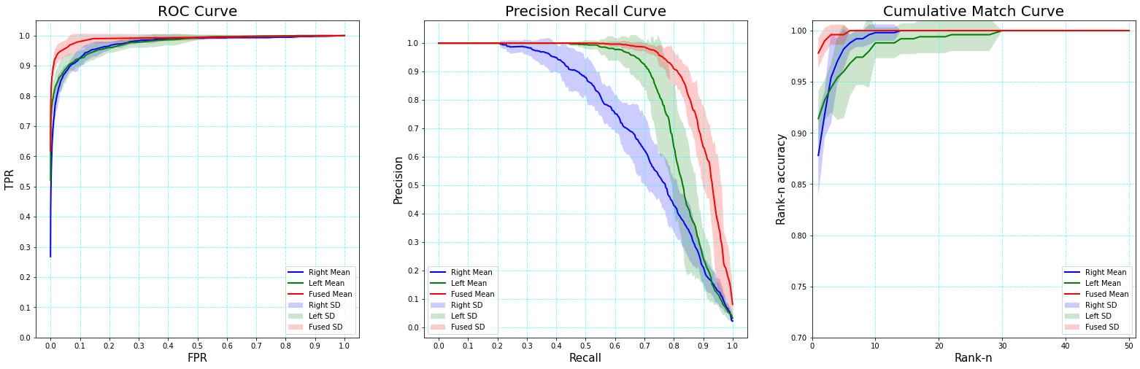
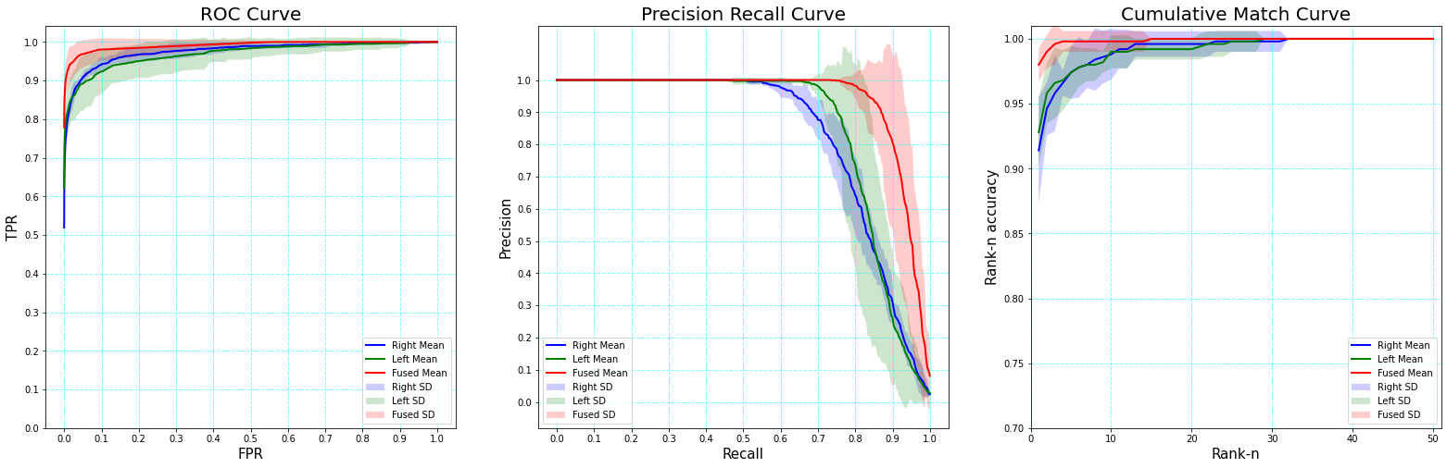
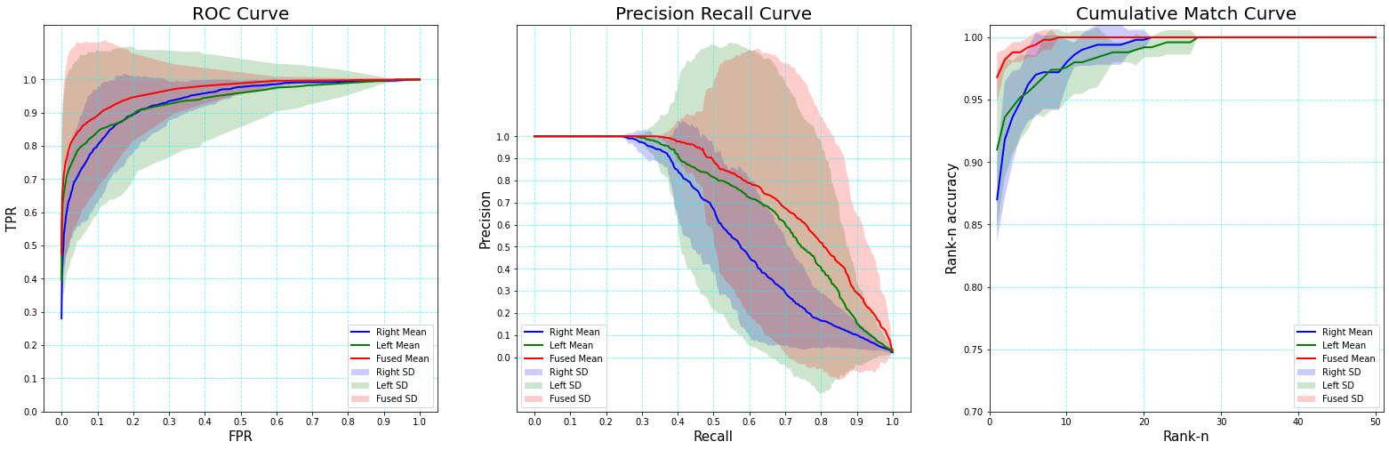
Comparing Results for L = 4 and No Parallel Paths (No Data Augmentation)
Top Row: For no parallel Paths
Bottom Row: With L = 4
Test Data is Clean
Test Data is Occluded

Slide 21
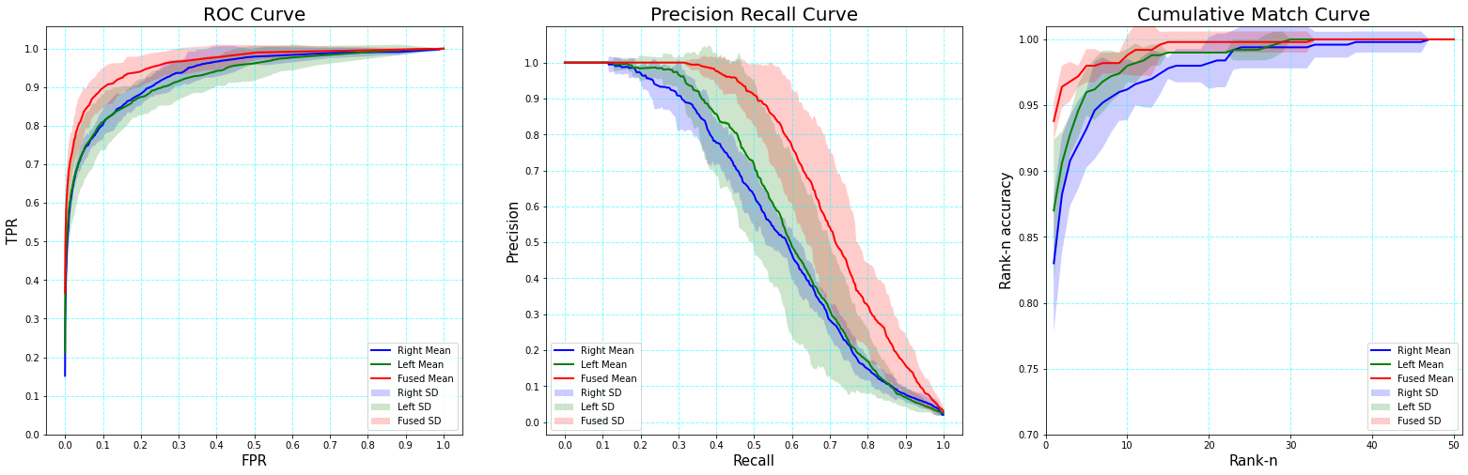
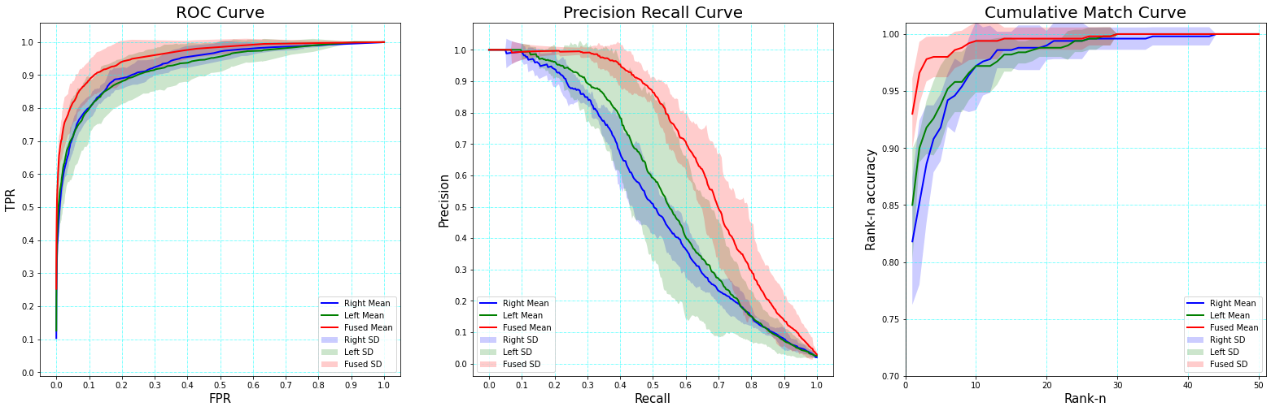
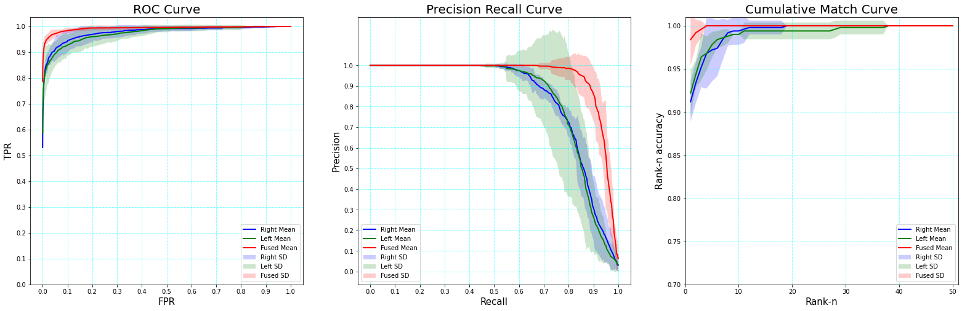
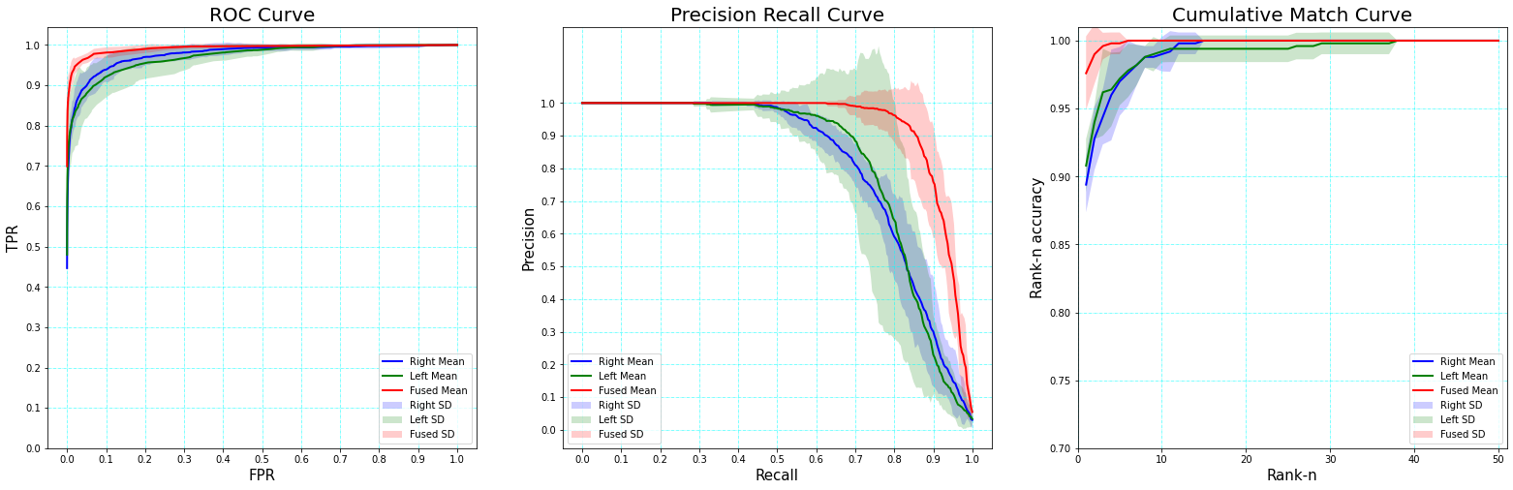
Comparing Results for L = 4 and No Parallel Paths (With Data Augmentation)
Top Row: For no parallel Paths
Bottom Row: With L = 4
Test Data is Clean
Test Data is Occluded

Slide 22
Numerical Results
Test set with no occlusions
 | Clean Training |  |  | Augmented Training
 | AUPR | EER | Rank-1 Acc. | AUPR | EER | Rank-1 Acc.
No Parallel | 94.23, 0.69 | 3.53, 0.34 | 98.8, 0.40 | 76.88, 3.19 | 8.64, 1.17 | 97.20, 1.16
Parallel L = 4 | 93.94, 1.35 | 3.47, 0.65 | 98.20, 1.16 | 93.58, 1.28 | 3.62, 0.63 | 99.40, 0.49
Parallel L = 8 | 93.50, 1.34 | 3.70, 0.51 | 97.60, 1.02 | 95.05, 0.82 | 3.08, 0.76 | 98.60, 0.80

Slide 23
Numerical Results
Test set with occlusions
 | Clean Training |  |  | Augmented Training
 | AUPR | EER | Rank-1 Acc. | AUPR | EER | Rank-1 Acc.
No Parallel | 89.73, 1.24 | 5.09, 0.37 | 98.80, 0.40 | 72.67, 2.42 | 9.56, 1.11 | 95.40, 1.50
Parallel L = 4 | 69.34, 14.33 | 13.59, 8.35 | 96.4, 1.35 | 92.38, 1.54 | 4.24, 0.76 | 99.00, 0.63
Parallel L = 8 | 84.79, 3.94 | 5.85, 1.42 | 97.20, 1.17 | 94.01, 0.89 | 3.54, 0.74 | 98.00, 0.89

Slide 24
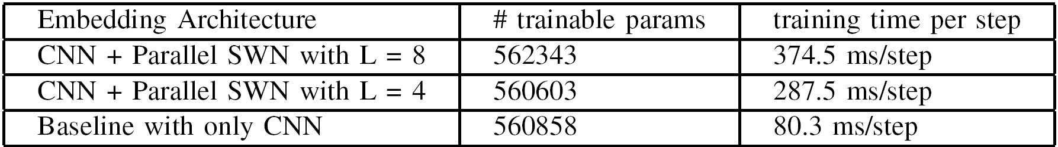
Size of embedding networks used and the corresponding average training time required per step for a batch-size of 100
There is very low increment in the number of trainable parameters as the learnable SWN blocks adds very little amount to the number of parameters.
The training time increases for parallel paths as backpropagation has to pass through multiple paths.

Slide 25
Future Scope
5

Slide 26
Conclusion and Future Scope
The results show an agility of a system to recognize occluded and non-occluded images using a common framework. We believe that it will perform equally with other biometric modalities.
The score-level fusion technique used in the research can also be used for multimodal biometric recognition systems.
As a part of future work, we will explore the utility of other types of wavelets and advanced information fusion methods.

Slide 27
References

Slide 28
References
P. Birajadar, M. Haria, S. G. Sangodkar, and V. Gadre, “Unconstrained ear recognition using deep scattering wavelet network,” in 2019 IEEE Bombay Section Signature Conference (IBSSC), pp. 1–6, 2019.
G. Koch, R. Zemel, R. Salakhutdinov, et al., “Siamese neural networks for one-shot image recognition,” in ICML deep learning workshop, vol. 2, p. 0, Lille, 2015.
H. Mirzaalian, T. K. Lee, and G. Hamarneh, “Hair enhancement in dermoscopic images using dual-channel quaternion tubularness filters and mrf-based multilabel optimization,” IEEE Transactions on Image Processing, vol. 23, no. 12, pp. 5486–5496, 2014.
J. Bruna and S. Mallat, “Invariant scattering convolution networks,” IEEE Transactions on Pattern Analysis and Machine Intelligence, vol. 35, no. 8, pp. 1872–1886, 2013.

Slide 29
References
S. G. Sangodkar, N. Suthar, A. Palde, P. Birajadar, and V. M. Gadre, “Ear recognition for multimedia security,” in Advanced Security Solutions for Multimedia, IOP Publishing, Sept. 2021.
F. Cotter and N. Kingsbury, “A learnable scatternet: Locally invariant convolutional layers,” in 2019 IEEE International Conference on Image Processing (ICIP), pp. 350–354, 2019.
M. Andreux, T. Angles, G. Exarchakis, R. Leonarduzzi, G. Rochette, L. Thiry, J. Zarka, S. Mallat, J. Andén, E. Belilovsky, J. Bruna, V. Lostanlen, M. Chaudhary, M. J. Hirn, E. Oyallon, S. Zhang, C. Cella, and M. Eickenberg, “Kymatio: Scattering transforms in python,” Journal of Machine Learning Research, vol. 21, no. 60, pp. 1–6, 2020.

Slide 30
References
E. E. Hansley, M. P. Segundo, and S. Sarkar, “Employing fusion of learned and handcrafted features for unconstrained ear recognition,” IET Biometrics, vol. 7, no. 3, pp. 215–223, 2018.
J. Bromley, I. Guyon, Y. LeCun, E. S¨ackinger, and R. Shah, “Signature verification using a” siamese” time delay neural network,” Advances in neural information processing systems, vol. 6, 1993.
F. Schroff, D. Kalenichenko, and J. Philbin, “Facenet: A unified embedding for face recognition and clustering,” in Proceedings of the IEEE Conference on Computer Vision and Pattern Recognition (CVPR), June 2015.
D. P. Kingma and J. Ba, “Adam: A method for stochastic optimization,” arXiv preprint arXiv:1412.6980, 2014.

Slide 31
Thank You

Slide 32
Questions?

